Slide 1
Hyper-heuristics Tutorial

Slide 2
Real-World Challenges
Researchers strive to make algorithms increasingly general-purpose
But practitioners have very specific needs
Designing custom algorithms tuned to particular problem instance distributions and/or computational architectures can be very time consuming

Slide 3
Automated Design of Algorithms
Addresses the need for custom algorithms
But due to high computational complexity, only feasible for repeated problem solving
Hyper-heuristics accomplish automated design of algorithms by searching program space

Slide 4
Hyper-heuristics
Hyper-heuristics are a special type of meta-heuristic
  Step 1: Extract algorithmic primitives from existing algorithms
  Step 2: Search the space of programs defined by the extracted primitives
While Genetic Programming (GP) is particularly well suited for executing Step 2, other meta-heuristics can be, and have been, employed
The type of GP employed matters [24]

Slide 5
Type of GP Matters:
Experiment Description
Implement five types of GP (tree GP, linear GP, canonical Cartesian GP, Stack GP, and Grammatical Evolution) in hyper-heuristics for evolving black-box search algorithms for solving 3-SAT
Base hyper-heuristic fitness on the fitness of the best search algorithm generated at solving the 3-SAT problem
Compare relative effectiveness of each GP type as a hyper-heuristic

Slide 6
GP Individual Description
Search algorithms are represented as an iterative algorithm that passes one or more set of variable assignments to the next iteration
Genetic program represents a single program iteration
Algorithm runs starting with a random initial population of solutions for 30 seconds

Slide 7
3-SAT Problem
A subset of the Boolean Satisfiability Problem (SAT)
The goal is to select values for Boolean variables such that a given Boolean equation evaluates as true (is satisfied)
Boolean equations are in 3-conjunctive normal form
Example:
  (A ∨ B ∨ C) ∧ (¬A ∨ ¬C ∨ D) ∧ (¬B ∨ C V ¬D)
  Satisfied by ¬A, B, C, ¬D
Fitness is the number of clauses satisfied by the best solution in the final population

Slide 8
Genetic Programming Nodes Used
Last population, Random population
Tournament selection, Fitness proportional selection, Truncation selection, Random selection
Bitwise mutation, Greedy flip, Quick greedy flip, Stepwise adaption of weights, Novelty
Union

Slide 9
Results

Slide 10
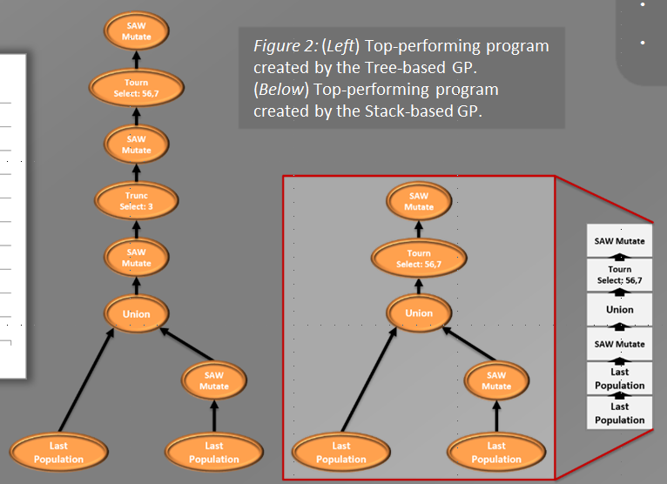
Results [24]

Slide 11
Results
Generated algorithms mostly performed comparably well on training and test problems
Tree and stack GP perform similarly well on this problem, as do linear and Cartesian GP
Tree and stack GP perform significantly better on this problem than linear and Cartesian GP, which perform significantly better than grammatical evolution

Slide 12
Conclusions
The choice of GP type makes a significant difference in the performance of the hyper-heuristic
The size of the search space appears to be a major factor in the performance of the hyper-heuristic

Slide 13
Case Study 1: The Automated Design of Crossover Operators [20]

Slide 14
Motivation
Performance Sensitive to Crossover Selection
Identifying & Configuring Best Traditional Crossover is Time Consuming
Existing Operators May Be Suboptimal
Optimal Operator May Change During Evolution

Slide 15
Some Possible Solutions
Meta-EA
  Exceptionally time consuming
Self-Adaptive Algorithm Selection
  Limited by algorithms it can choose from

Slide 16
Self-Configuring Crossover (SCX)
Each Individual Encodes a Crossover Operator
Crossovers Encoded as a List of Primitives
  Swap
  Merge
Each Primitive has three parameters
  Number, Random, or Inline
Offspring Crossover
Swap(3, 5, 2)
Merge(1, r, 0.7)
Swap(r, i, r)

Slide 17
Applying an SCX
Concatenate Genes
Parent 1 Genes
Parent 2 Genes
1.0
2.0
3.0
4.0
5.0
6.0
7.0
8.0

Slide 18
The Swap Primitive
Each Primitive has a type
  Swap represents crossovers that move genetic material
First Two Parameters
  Start 1 Position
  Start 2 Position
Third Parameter Primitive Dependent
  Swaps use “Width”
Swap(3, 5, 2)

Slide 19
Applying an SCX
Concatenate Genes
Offspring Crossover
1.0
2.0
3.0
4.0
3.0
5.0
4.0
6.0
5.0
7.0
6.0
8.0
Swap(3, 5, 2)
Merge(1, r, 0.7)
Swap(r, i, r)

Slide 20
The Merge Primitive
Third Parameter Primitive Dependent
  Merges use “Weight”
Random Construct
  All past primitive parameters used the Number construct
  “r” marks a primitive using the Random Construct
  Allows primitives to act stochastically
Merge(1, r, 0.7)

Slide 21
Applying an SCX
Concatenate Genes
Offspring Crossover
1.0
2.0
5.0
6.0
3.0
4.0
7.0
8.0
Swap(3, 5, 2)
0.7
g(i) = α*g(i) + (1-α)*g(j)
Merge(1, r, 0.7)
g(1) = 1.0*(0.7) + 6.0*(1-0.7)
g(2) = 6.0*(0.7) + 1.0*(1-0.7)
2.5
4.5
Swap(r, i, r)

Slide 22
The Inline Construct
Only Usable by First Two Parameters
Denoted as “i”
Forces Primitive to Act on the Same Loci in Both Parents
Swap(r, i, r)

Slide 23
Applying an SCX
Concatenate Genes
Offspring Crossover
2.5
2.0
5.0
4.5
3.0
4.0
7.0
8.0
2.0
4.0
Swap(3, 5, 2)
Merge(1, r, 0.7)
Swap(r, i, r)

Slide 24
Applying an SCX
Remove Exess Genes
Concatenate Genes
2.5
4.0
5.0
4.5
3.0
2.0
7.0
8.0
Offspring Genes

Slide 25
Evolving Crossovers
Parent 2 Crossover
Parent 1 Crossover
Offspring Crossover
Swap(r, 7, 3)
Merge(i, 8, r)
Swap(3, 5, 2)
Swap(4, 2, r)
Merge(1, r, 0.7)
Merge(r, r, r)
Swap(r, i, r)

Slide 26
Empirical Quality Assessment
Compared Against
  Arithmetic Crossover
  N-Point Crossover
  Uniform Crossover
On Problems
  Rosenbrock
  Rastrigin
  Offset Rastrigin
  NK-Landscapes
  DTrap
Problem | Comparison | SCX
Rosenbrock | -86.94 (54.54) | -26.47 (23.33)
Rastrigin | -59.2 (6.998) | -0.0088 (0.021)
Offset Rastrigin | -0.1175 (0.116) | -0.03 (0.028)
NK | 0.771 (0.011) | 0.8016 (0.013)
DTrap | 0.9782 (0.005) | 0.9925 (0.021)

Slide 27
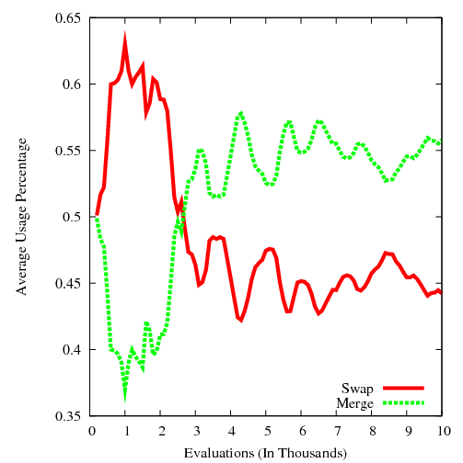
Adaptations: Rastrigin

Slide 28
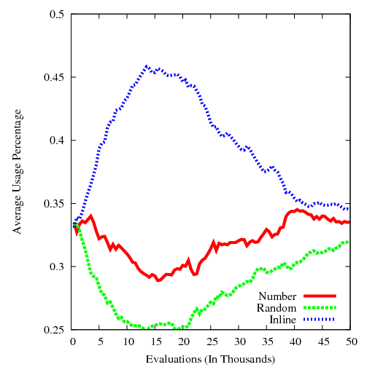
Adaptations: DTrap

Slide 29
SCX Overhead
Requires No Additional Evaluation
Adds No Significant Increase in Run Time
  All linear operations
Adds Initial Crossover Length Parameter
  Testing showed results fairly insensitive to this parameter
  Even worst settings tested achieved better results than comparison operators

Slide 30
Conclusions
Remove Need to Select Crossover Algorithm
Better Fitness Without Significant Overhead
Benefits From Dynamically Changing Operator
Promising Approach for Evolving Crossover Operators for Additional Representations (e.g., Permutations)

Slide 31
Case Study 2: The Automated Design of Black Box Search Algorithms [21, 23, 25]

Slide 32
Approach
Hyper-Heuristic employing Genetic Programing
Post-ordered parse tree
Evolve the iterated function

Slide 33
Our Solution
Initialization
Check for Termination
Iterated Function
Terminate

Slide 34
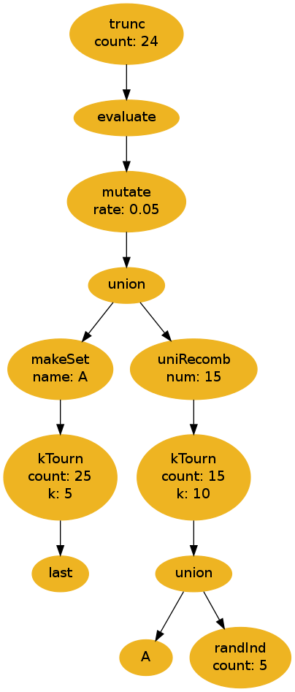
Our Solution
Hyper-Heuristic employing Genetic Programing
Post-ordered parse tree
Evolve the iterated function
High-level primitives

Slide 35
Parse Tree
Iterated function
Sets of solutions
Function returns a set of solutions accessible to the next iteration

Slide 36
Primitive Types
Variation Primitives
Selection Primitives
Set Primitives
Evaluation Primitive
Terminal Primitives

Slide 37
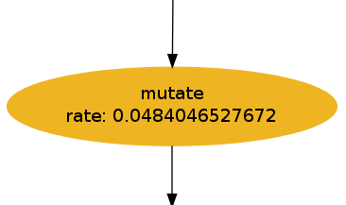
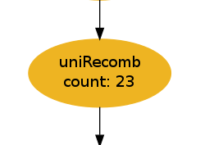
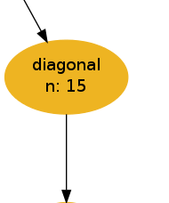
Variation Primitives
Bit-flip Mutation
  rate
Uniform Recombination
  count
Diagonal Recombination
  n

Slide 38
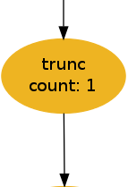
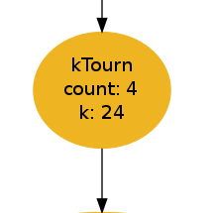
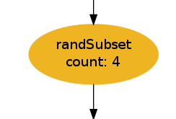
Selection Primitives
Truncation Selection
  count
K-Tournament Selection
  k
  count
Random Sub-set Selection
  count

Slide 39
Set-Operation Primitives
Make Set
  name
Persistent Sets
  name
Union

Slide 40
Evaluation Primitive
Evaluates the nodes passed in
Allows multiple operations and accurate selections within an iteration
  Allows for deception

Slide 41
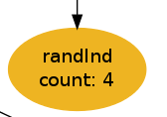
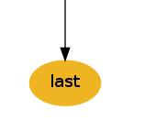

Terminal Primitives
Random Individuals
  count
`Last’ Set
Persistent Sets
  name

Slide 42
Meta-Genetic Program
Create Valid Population
Select Survivors
Check
Termination
Generate Children
Evaluate
Children

Slide 43
BBSA Evaluation
Create Valid Population
Select Survivors
Generate Children
Generate Children
Evaluate
Children

Slide 44
Termination Conditions
Evaluations
Iterations
Operations
Convergence

Slide 45
Proof of Concept Testing
Deceptive Trap Problem
0 | 0 | 1 | 1 | 0
0 | 1 | 0 | 1 | 0
1 | 1 | 1 | 1 | 0

Slide 46
Proof of Concept Testing (cont.)
Evolved Problem Configuration
  Bit-length = 100
  Trap Size = 5
Verification Problem Configurations
  Bit-length = 100, Trap Size = 5
  Bit-length = 200, Trap Size = 5
  Bit-length = 105, Trap Size = 7
  Bit-length = 210, Trap Size = 7

Slide 47
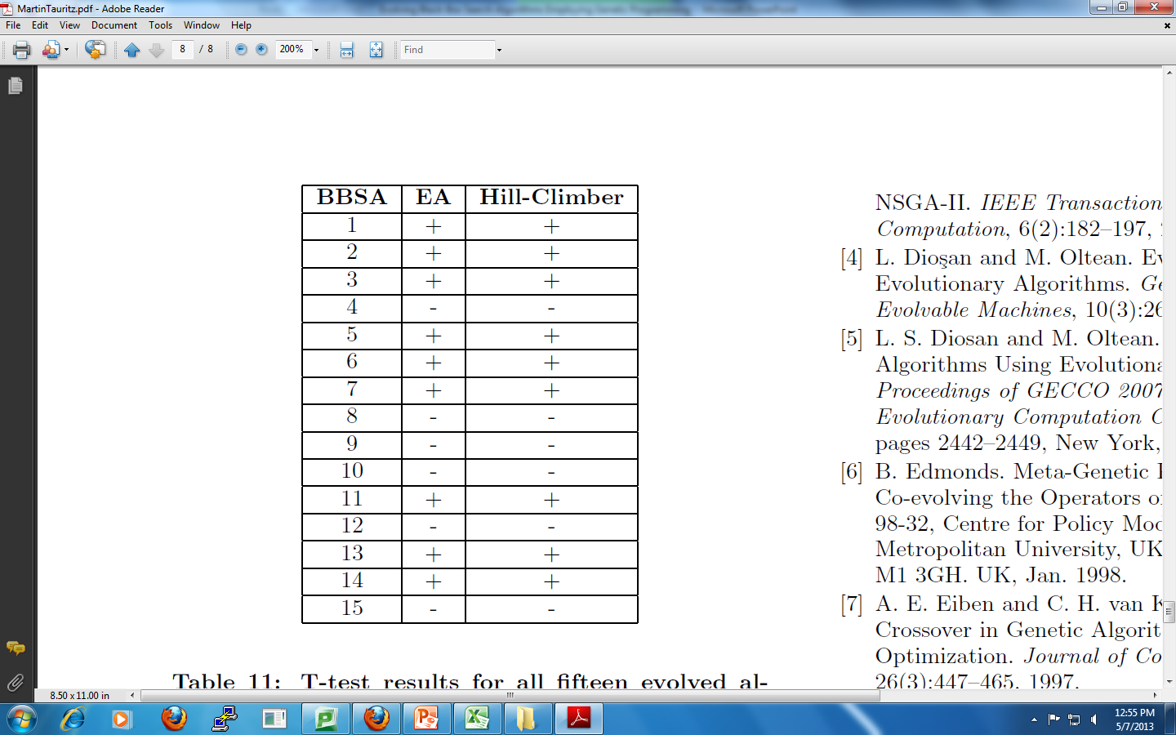
Results
60% Success Rate

Slide 48
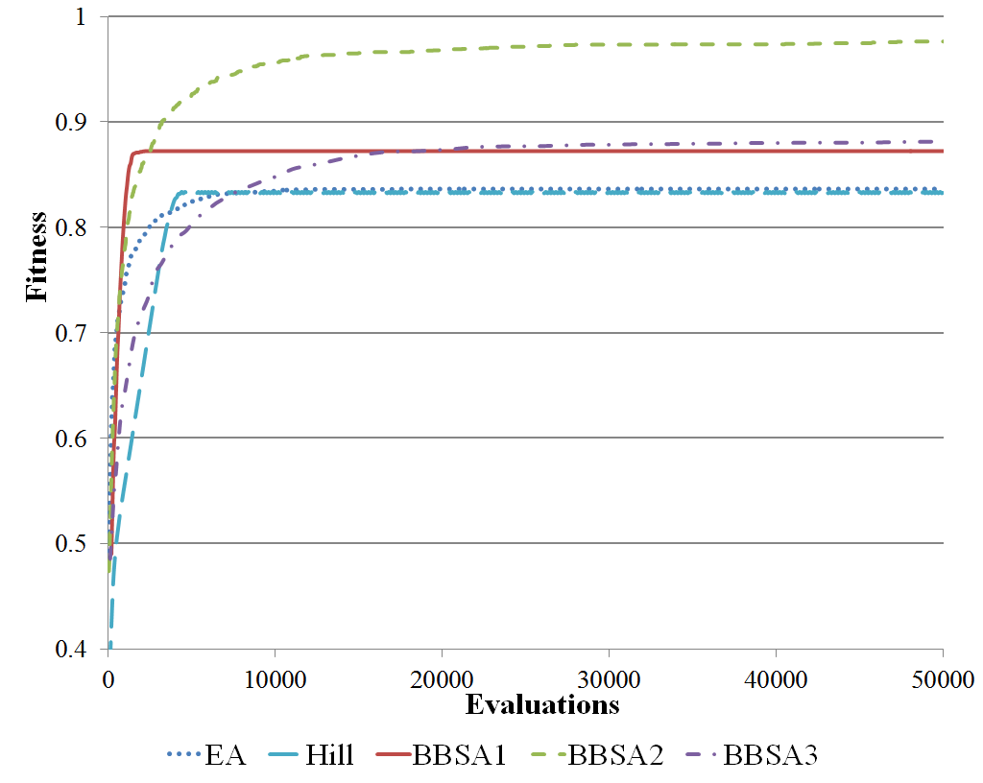
Results:
Bit-Length = 100
Trap Size = 5

Slide 49
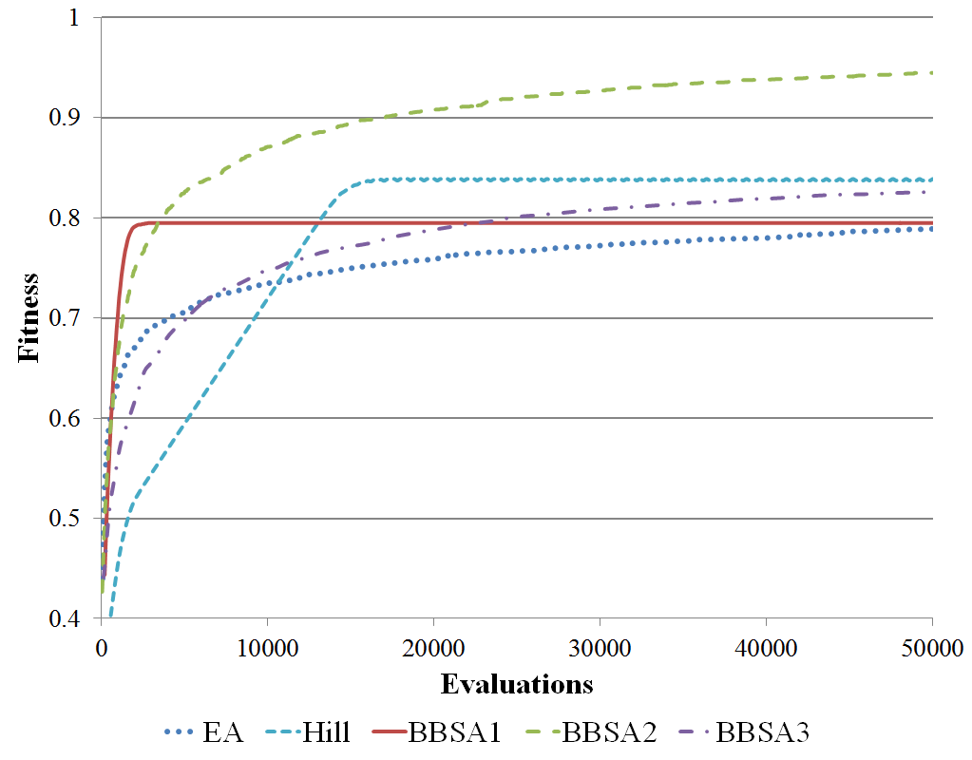
Results:
Bit-Length = 200
Trap Size = 5

Slide 50
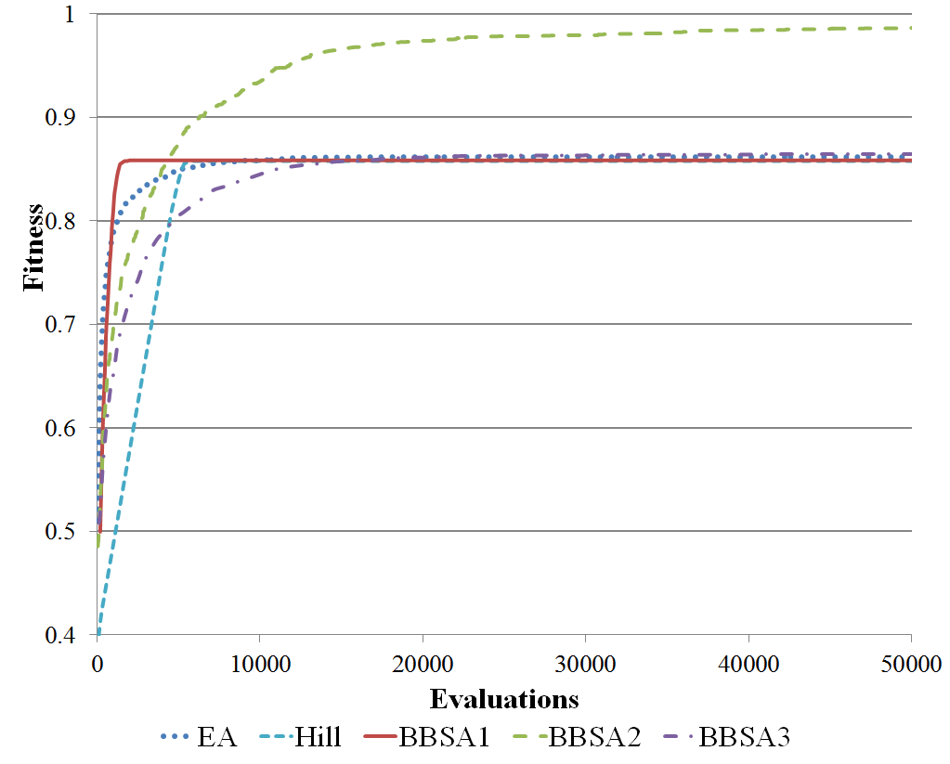
Results:
Bit-Length = 105
Trap Size = 7

Slide 51
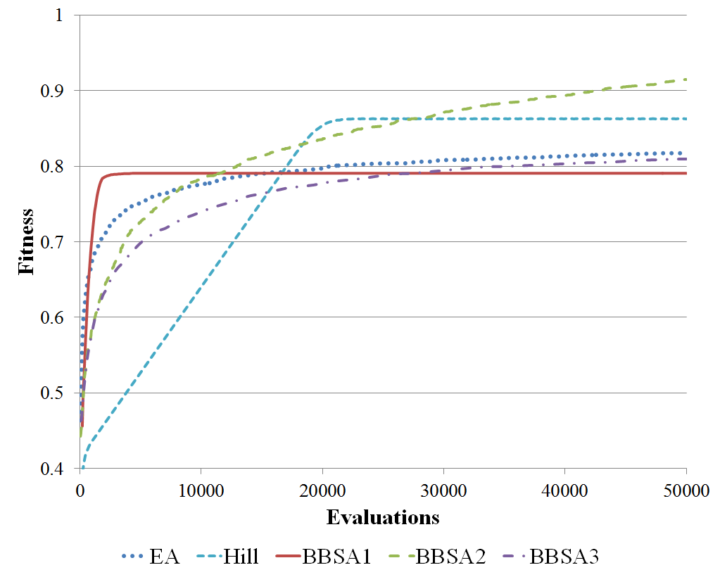
Results:
Bit-Length = 210
Trap Size = 7

Slide 52
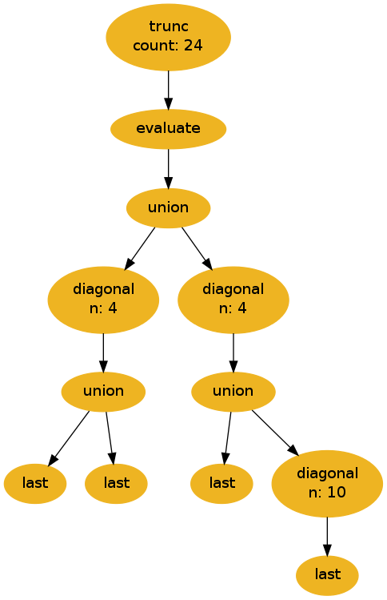
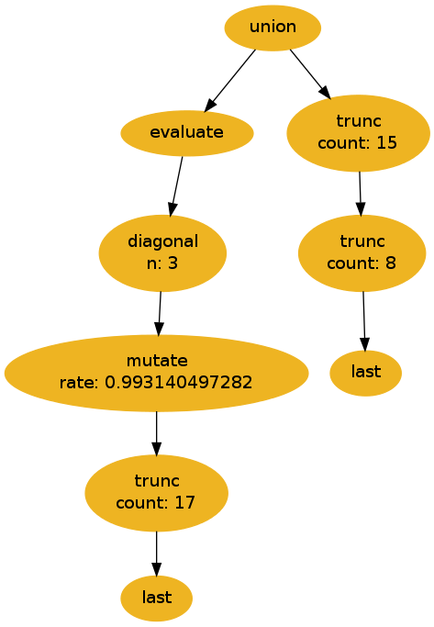
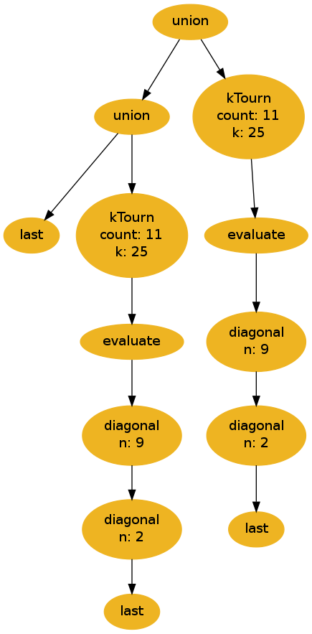
BBSA2
BBSA1
BBSA3

Slide 53
BBSA1

Slide 54
BBSA2

Slide 55
BBSA3

Slide 56
BBSA2

Slide 57
Over-Specialization
Trained Problem Configuration
Alternate Problem Configuration

Slide 58
Robustness
Measures of Robustness
  Applicability
  Fallibility
Applicability
  What area of the problem configuration space do I perform well on?
Fallibility
  If a given BBSA doesn’t perform well, how much worse will I perform?

Slide 59
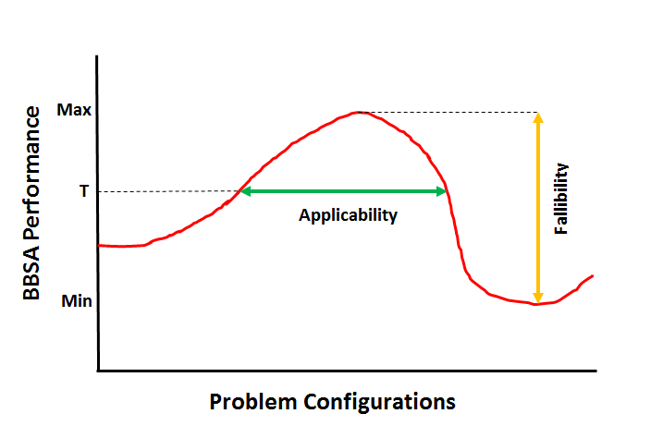
Robustness

Slide 60
Multi-Sampling
Train on multiple problem configurations
Results in more robust BBSAs
Provides the benefit of selecting the region of interest on the problem configuration landscape

Slide 61
Multi-Sample Testing
Deceptive Trap Problem
0 | 0 | 1 | 1 | 0
0 | 1 | 0 | 1 | 0
1 | 1 | 1 | 1 | 0

Slide 62
Multi-Sample Testing (cont.)
Multi-Sampling Evolution
  Levels 1-5
Training Problem Configurations
  Bit-length = 100, Trap Size = 5
  Bit-length = 200, Trap Size = 5
  Bit-length = 105, Trap Size = 7
  Bit-length = 210, Trap Size = 7
  Bit-length = 300, Trap Size = 5

Slide 63
Initial Test Problem Configurations
  Bit-length = 100, Trap Size = 5
  Bit-length = 200, Trap Size = 5
  Bit-length = 105, Trap Size = 7
  Bit-length = 210, Trap Size = 7
  Bit-length = 300, Trap Size = 5
  Bit-length = 99, Trap Size = 9
  Bit-length = 198, Trap Size = 9
  Bit-length = 150, Trap Size = 5
  Bit-length = 250, Trap Size = 5
  Bit-length = 147, Trap Size = 7
  Bit-length = 252, Trap Size = 7

Slide 64
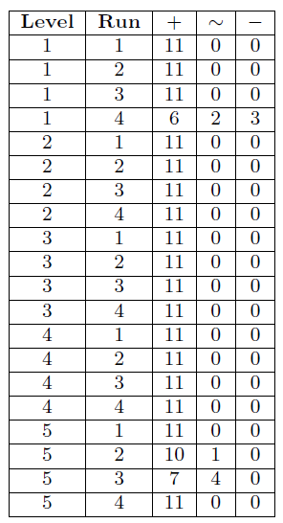
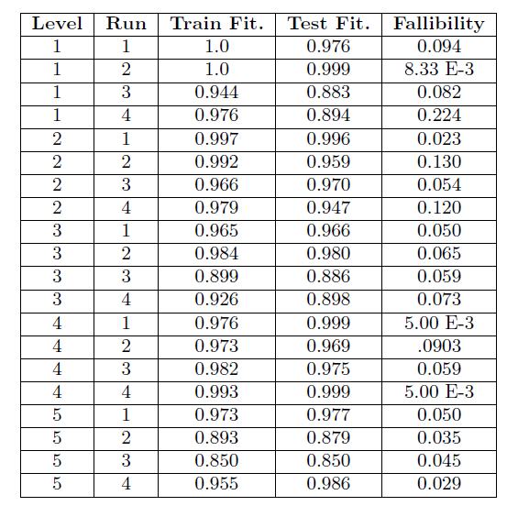
Initial Results

Slide 65
Problem Configuration Landscape Analysis
Run evolved BBSAs on wider set of problem configurations
Bit-length: ~75-~500
Trap Size: 4-20

Slide 66
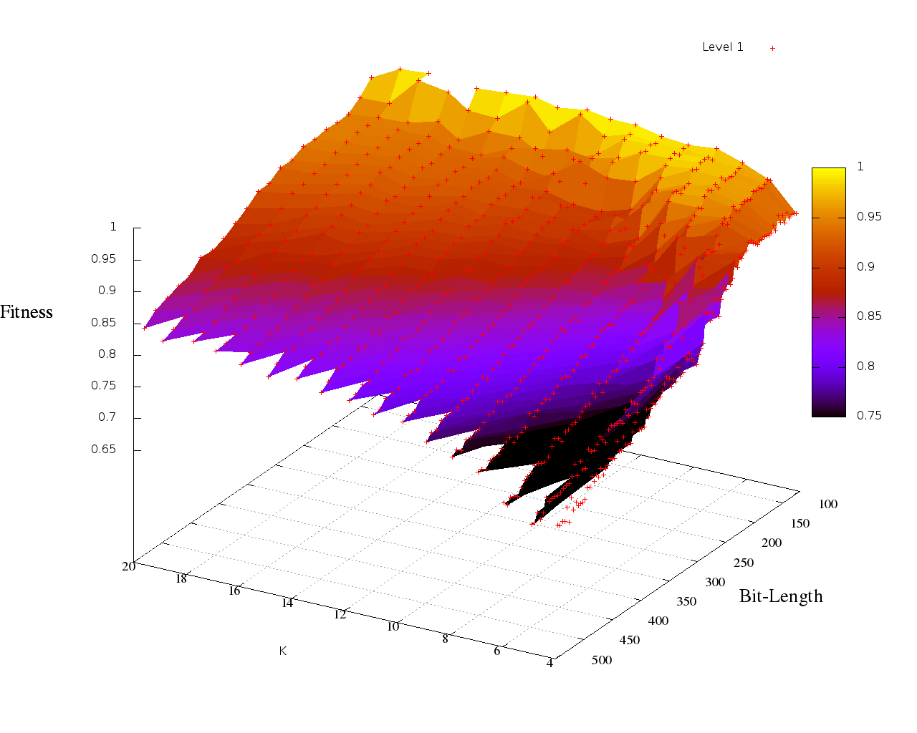
Results: Multi-Sampling Level 1

Slide 67
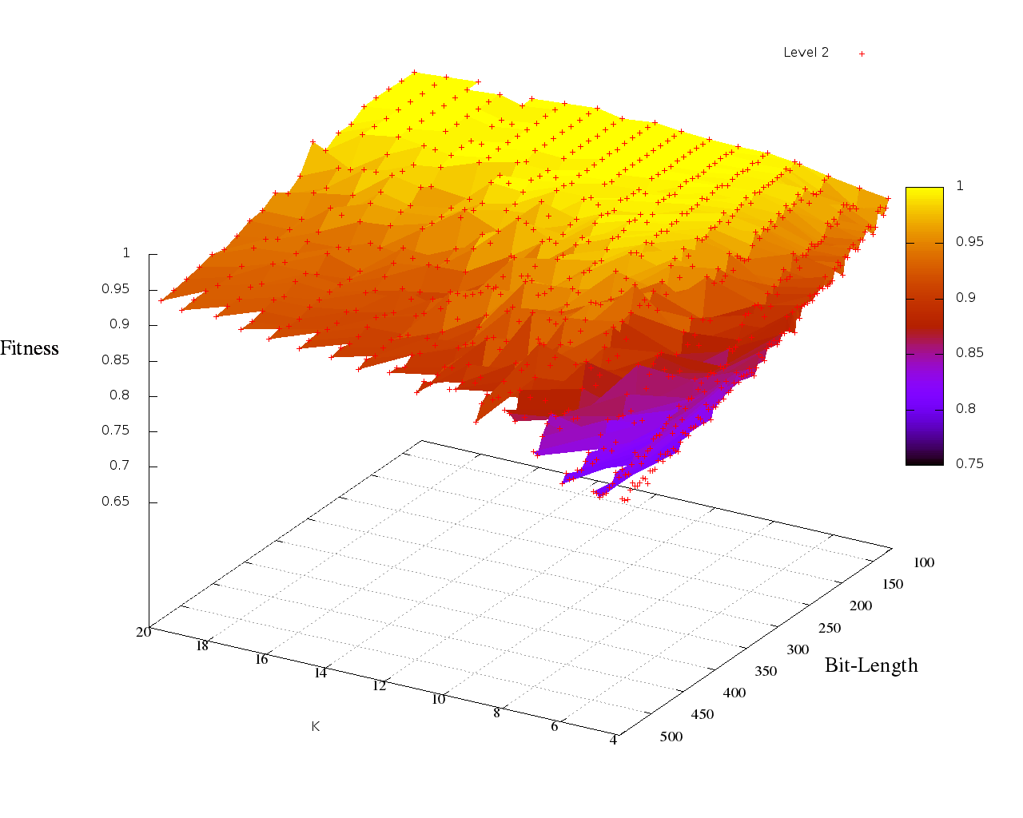
Results: Multi-Sampling Level 2

Slide 68
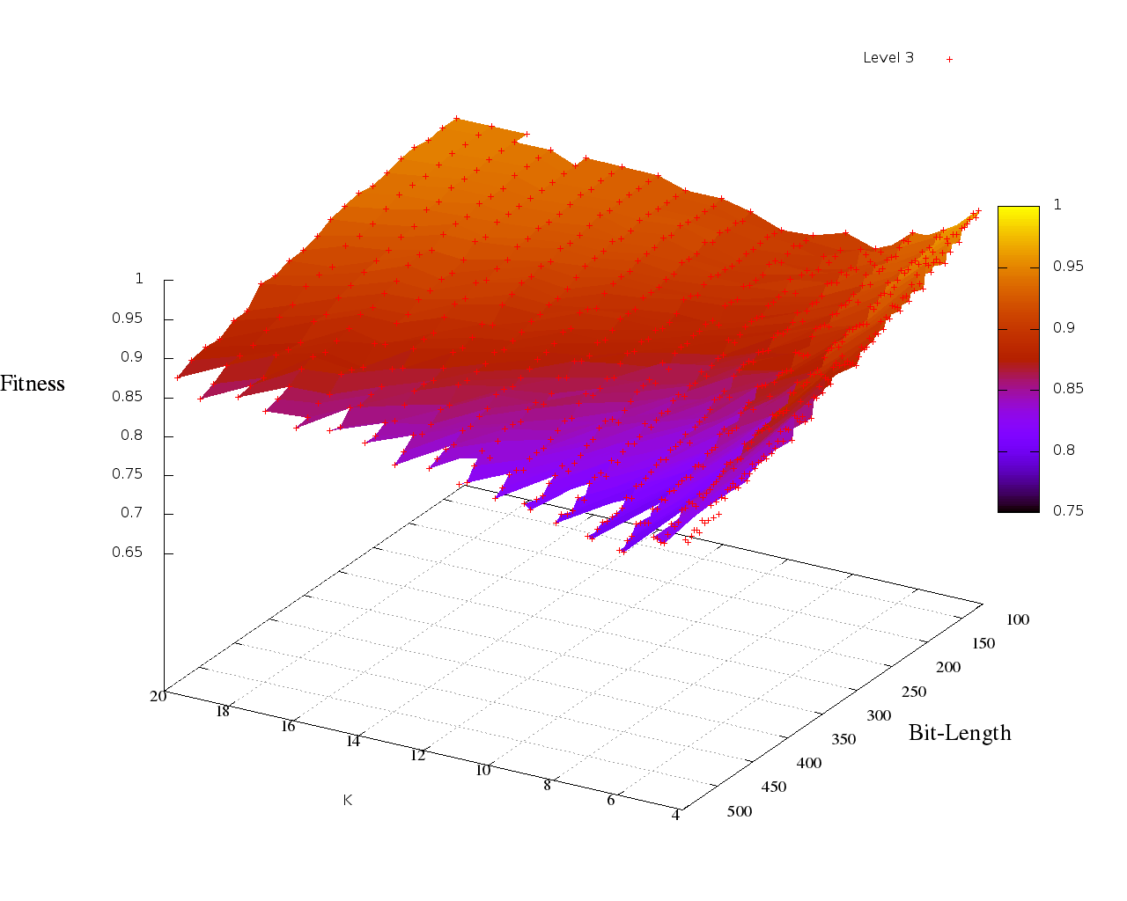
Results: Multi-Sampling Level 3

Slide 69
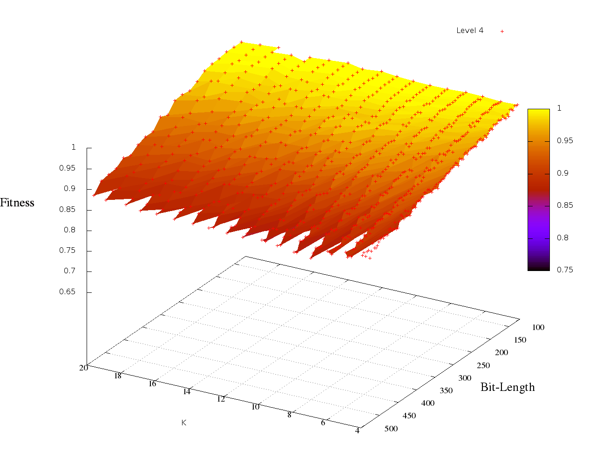
Results: Multi-Sampling Level 4

Slide 70
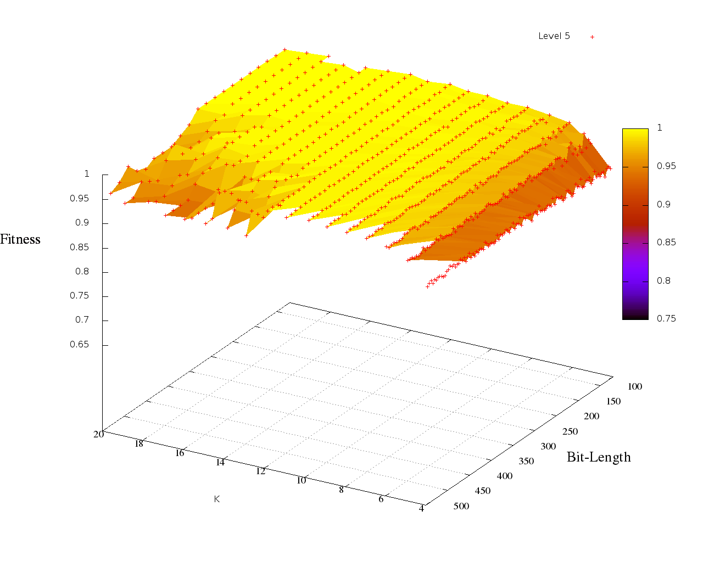
Results: Multi-Sampling Level 5

Slide 71
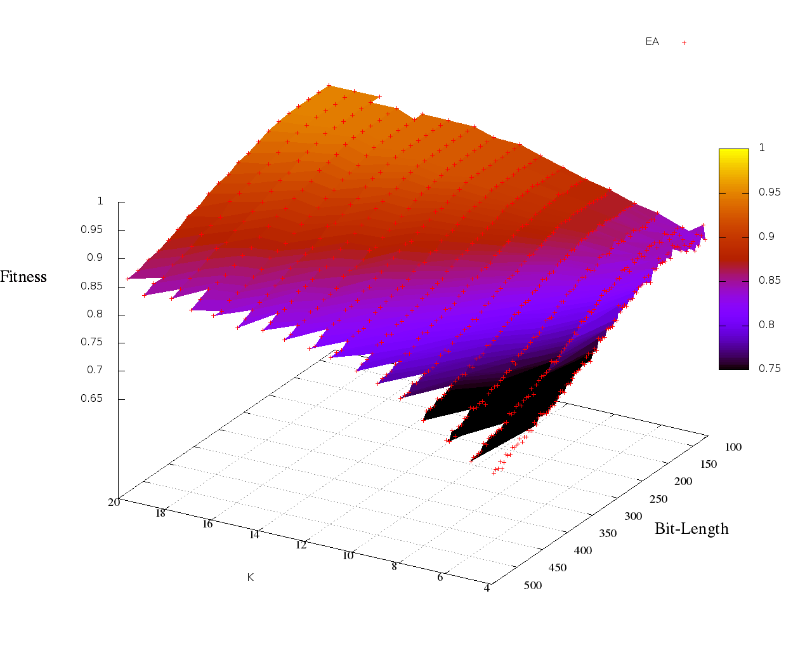
Results: EA Comparison

Slide 72
Robustness: Fallibility
Multi-Sample Level 5
Standard EA

Slide 73
Robustness: Fallibility
Multi-Sample Level 1
Standard EA

Slide 74
Robustness: Applicability
Multi-Sample Level 1
Multi-Sample Level 5

Slide 75
Robustness: Fallibility

Slide 76
Drawbacks
Increased computational time
  More runs per evaluation (increased wall time)
  More problem configurations to optimize for (increased evaluations)

Slide 77
Summary of Multi-Sample Improvements
Improved Hyper-Heuristic to evolve more robust BBSAs
Evolved custom BBSA which outperformed standard EA and were robust to changes in problem configuration

Slide 78
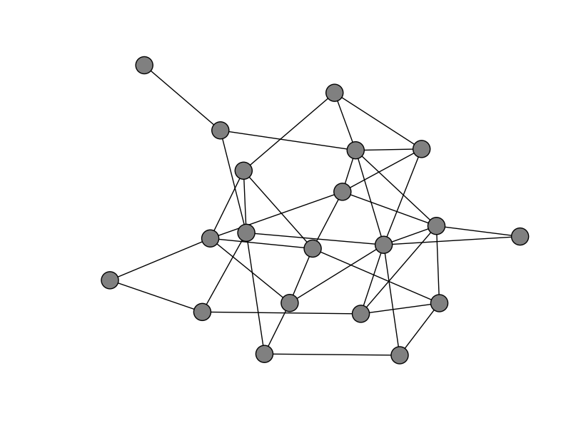
Case Study 3: Evolving Random Graph Generators: A Case for Increased Algorithmic Primitive Granularity [27]

Slide 79
Random Graphs
Graphs are a powerful modeling tool
  Computer and social networks
  Transportation and power grids
Algorithms designed for graphs
  Community detection and graph partitioning
  Network routing and intrusion detection
Random graphs provide test data
Prediction using random graphs
  Spread of disease
  Deployment of wireless sensors

Slide 80
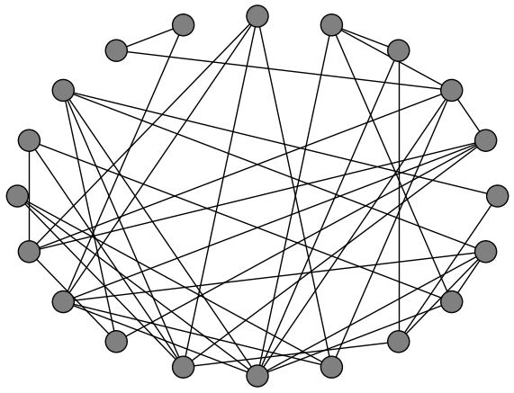
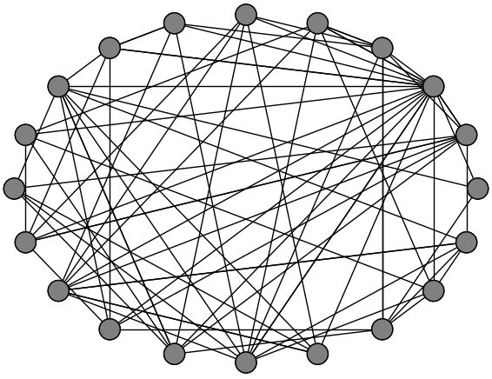
Traditional Random Graph Models
Erdös-Rényi
Barabási-Albert

Slide 81
Automated Random Graph Model Design
Random graph model needs to accurately reflect intended concept
Model selection can be automated, but relies on having a good solution available
Developing an accurate model for a new application can be difficult
Can the model design process be automated to produce an accurate graph model given examples?

Slide 82
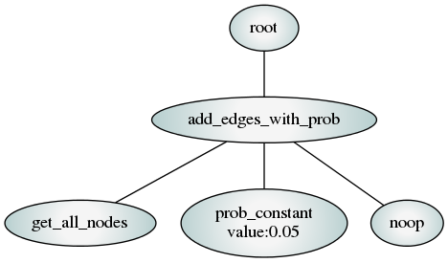
Hyper-heuristic Approach
Extract functionality from existing graph generation techniques
Use Genetic Programming (GP) to construct new random graph algorithms

Slide 83
Previous Attempts at Evolving Random Graph Generators
Assumes “growth” model, adding one node at a time
Does well at reproducing traditional models
Not demonstrated to do well at generating real complex networks
Limits the search space of possible solutions

Slide 84
Increased Algorithmic Primitive Granularity
Remove the assumed “growth” structure
More flexible lower-level primitive set
Benefit: Can represent a larger variety of algorithms
Drawback: Larger search space, increasing complexity

Slide 85
Methodology
NSGA-II evolves population of random graph models
Strongly typed parse tree representation
Centrality distributions used to evaluate solution
quality (degree, betweenness, PageRank)

Slide 86
Primitive Operations
Terminals
Graph elements: nodes, edges
Graph properties: average degree, size, order
Constants: integers, probabilities, Booleans, user inputs
No-op terminators
Functions
Basic programming constructs: for, while, if-else
Data structures: lists of values, nodes, or edges, list
combining/selection/sorting
Math and logic operators: add, multiply, <, ==, AND, OR
Graph operators: add edges, add subgraph, rewire edges

Slide 87
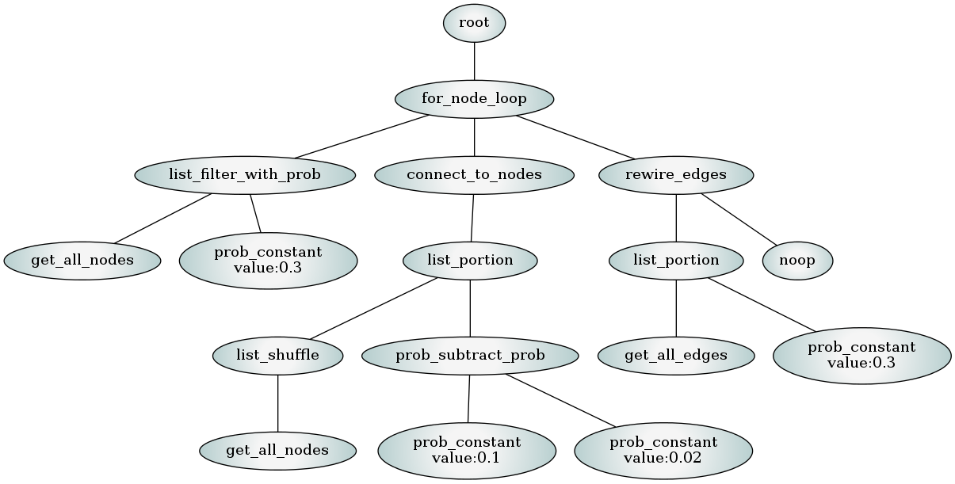
Example Evolved Random Graph Generator

Slide 88
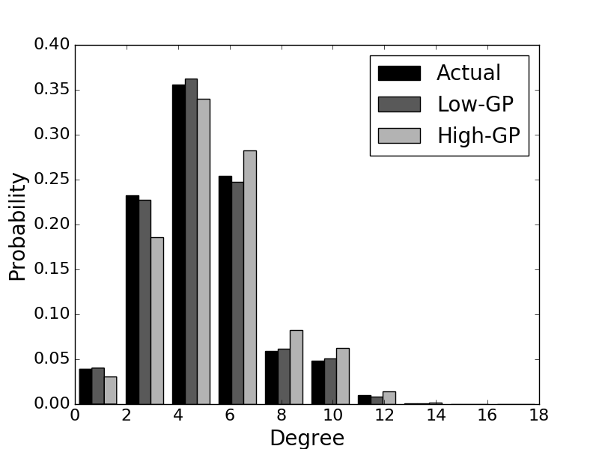
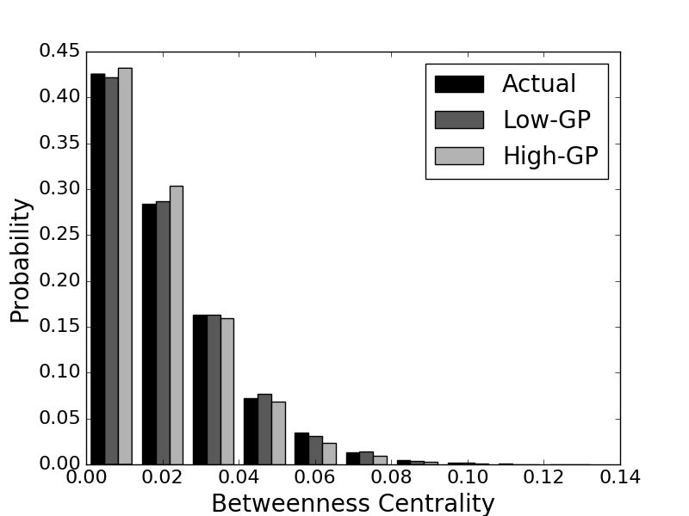
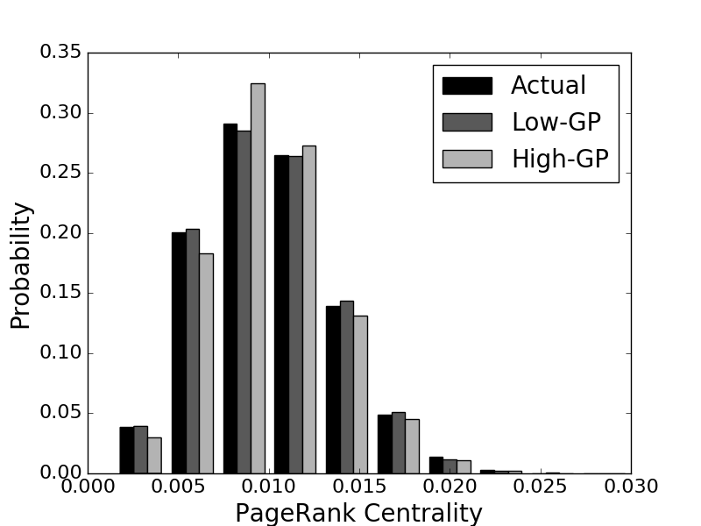
Reproducing Erdös-Rényi
 | Low-GP |  |  | High-GP
Metric | Mean | σ | Comparison | Mean | σ
Degree | 0.101 | 0.048 | = | 0.108 | 0.047
Betweenness | 0.104 | 0.031 | = | 0.105 | 0.033
PageRank | 0.110 | 0.032 | = | 0.112 | 0.029

Slide 89
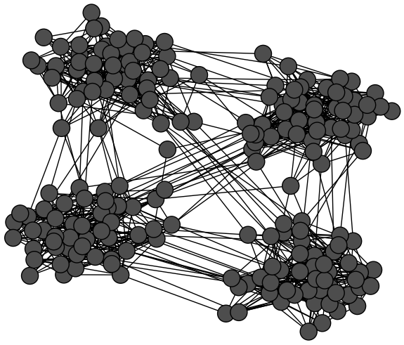
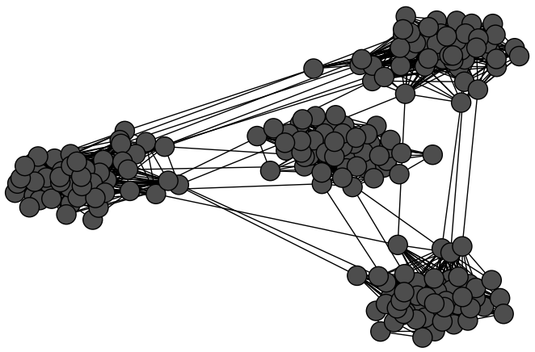
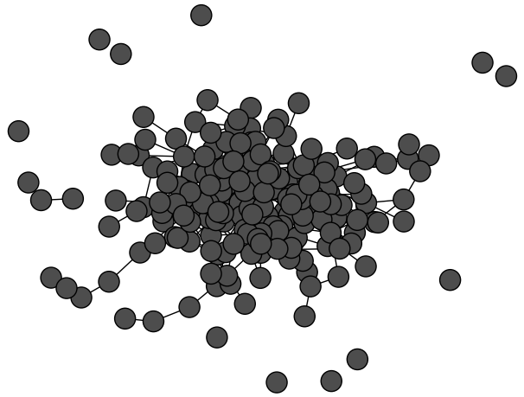
Reproducing Random Community Graphs
 | Low-GP |  |  | High-GP
Metric | Mean | σ | Comparison | Mean | σ
Degree | 0.436 | 0.075 | < | 0.458 | 0.055
Betweenness | 0.209 | 0.105 | < | 0.320 | 0.126
PageRank | 0.127 | 0.029 | < | 0.150 | 0.036
Actual Graph Low-GP High-GP

Slide 90
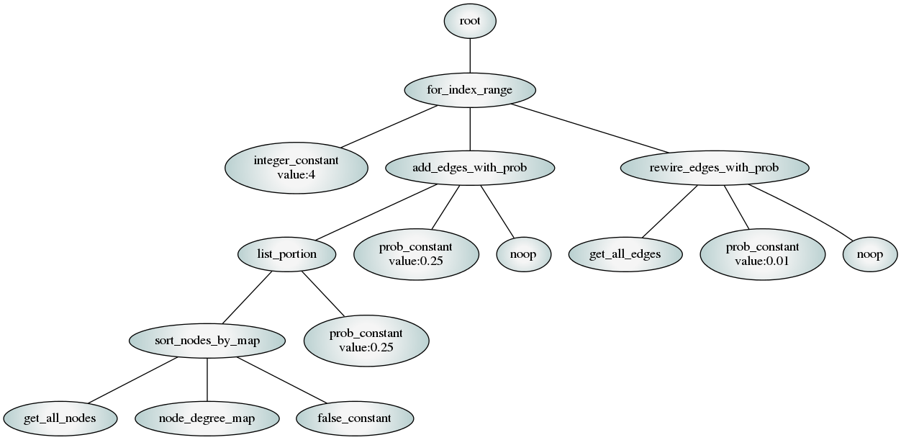
Evolved Random Collaboration Network Generator

Slide 91
Conclusion
Traditional random graph models do not always produce appropriate representations of certain concepts
Accurate random graph model design can be automated using genetic programming
More flexible set of low-level primitive operations increases resulting model accuracy
Increase in a priori evolution time is amortized over repeated use of the evolved solutions

Slide 92
Some Final Thoughts

Slide 93
Challenges in Hyper-heuristics
Hyper-heuristics are very computationally expensive (use Asynchronous Parallel GP [26,30])
What is the best primitive granularity? (see next slide)
How to automate decomposition and recomposition of primitives?
How to automate primitive extraction?
How does hyper-heuristic performance scale for increasing primitive space size? (see [25,27])

Slide 94
Primitive Granularity
Algorithm
Primitives
Full BBSAs
i.e., EA, SA, SAHC, etc.
Selective Hyper-heuristics
Generative Hyper-heuristics
High-level BBSA operations
i.e., Truncation Selection, Bit-Flip Mutation, etc.
Our Hyper-heuristic
Low-level BBSA operations
i.e., If Converged Statements, For loops, etc.
Genetic Programming
Turing Complete Set of Primitives

Slide 95
References 1
John Woodward. Computable and Incomputable Search Algorithms and Functions. IEEE International Conference on Intelligent Computing and Intelligent Systems (IEEE ICIS 2009), pages 871-875, Shanghai, China, November 20-22, 2009.
John Woodward. The Necessity of Meta Bias in Search Algorithms. International Conference on Computational Intelligence and Software Engineering (CiSE), pages 1-4, Wuhan, China, December 10-12, 2010.
John Woodward & Ruibin Bai. Why Evolution is not a Good Paradigm for Program Induction: A Critique of Genetic Programming. In Proceedings of the first ACM/SIGEVO Summit on Genetic and Evolutionary Computation, pages 593-600, Shanghai, China, June 12-14, 2009.
Jerry Swan, John Woodward, Ender Ozcan, Graham Kendall, Edmund Burke. Searching the Hyper-heuristic Design Space. Cognitive Computation, 6:66-73, 2014.
Gisele L. Pappa, Gabriela Ochoa, Matthew R. Hyde, Alex A. Freitas, John Woodward, Jerry Swan. Contrasting meta-learning and hyper-heuristic research. Genetic Programming and Evolvable Machines, 15:3-35, 2014.
Edmund K. Burke, Matthew Hyde, Graham Kendall, and John Woodward. Automating the Packing Heuristic Design Process with Genetic Programming. Evolutionary Computation, 20(1):63-89, 2012.
Edmund K. Burke, Matthew R. Hyde, Graham Kendall, and John Woodward. A Genetic Programming Hyper-Heuristic Approach for Evolving Two Dimensional Strip Packing Heuristics. IEEE Transactions on Evolutionary Computation, 14(6):942-958, December 2010.

Slide 96
References 2
Edmund K. Burke, Matthew R. Hyde, Graham Kendall, Gabriela Ochoa, Ender Ozcan and John R. Woodward. Exploring Hyper-heuristic Methodologies with Genetic Programming, Computational Intelligence: Collaboration, Fusion and Emergence, In C. Mumford and L. Jain (eds.), Intelligent Systems Reference Library, Springer, pp. 177-201, 2009.
Edmund K. Burke, Matthew Hyde, Graham Kendall and John R. Woodward. The Scalability of Evolved On Line Bin Packing Heuristics. In Proceedings of the IEEE Congress on Evolutionary Computation, pages 2530-2537, September 25-28, 2007.
R. Poli, John R. Woodward, and Edmund K. Burke. A Histogram-matching Approach to the Evolution of Bin-packing Strategies. In Proceedings of the IEEE Congress on Evolutionary Computation, pages 3500-3507, September 25-28, 2007.
Edmund K. Burke, Matthew Hyde, Graham Kendall, and John Woodward. Automatic Heuristic Generation with Genetic Programming: Evolving a Jack-of-all-Trades or a Master of One, In Proceedings of the Genetic and Evolutionary Computation Conference, pages 1559-1565, London, UK, July 2007.
John R. Woodward and Jerry Swan. Template Method Hyper-heuristics, Metaheuristic Design Patterns (MetaDeeP) workshop, GECCO Comp’14, pages 1437-1438, Vancouver, Canada, July 12-16, 2014.
Saemundur O. Haraldsson and John R. Woodward, Automated Design of Algorithms and Genetic Improvement: Contrast and Commonalities, 4th Workshop on Automatic Design of Algorithms (ECADA), GECCO Comp ‘14, pages 1373-1380, Vancouver, Canada, July 12-16, 2014.

Slide 97
References 3
John R. Woodward, Simon P. Martin and Jerry Swan. Benchmarks That Matter For Genetic Programming, 4th Workshop on Evolutionary Computation for the Automated Design of Algorithms (ECADA), GECCO Comp ‘14, pages 1397-1404, Vancouver, Canada, July 12-16, 2014.
John R. Woodward and Jerry Swan. The Automatic Generation of Mutation Operators for Genetic Algorithms, 2nd Workshop on Evolutionary Computation for the Automated Design of Algorithms (ECADA), GECCO Comp’ 12, pages 67-74, Philadelphia, U.S.A., July 7-11, 2012.
John R. Woodward and Jerry Swan. Automatically Designing Selection Heuristics. 1st Workshop on Evolutionary Computation for Designing Generic Algorithms, pages 583-590, Dublin, Ireland, 2011.
Edmund K. Burke, Matthew Hyde, Graham Kendall, Gabriela Ochoa, Ender Ozcan, and John Woodward. A Classification of Hyper-heuristics Approaches, Handbook of Metaheuristics, pages 449-468, International Series in Operations Research & Management Science, M. Gendreau and J-Y Potvin (Eds.), Springer, 2010.
Libin Hong and John Woodward and Jingpeng Li and Ender Ozcan. Automated Design of Probability Distributions as Mutation Operators for Evolutionary Programming Using Genetic Programming. Proceedings of the 16th European Conference on Genetic Programming (EuroGP 2013), volume 7831, pages 85-96, Vienna, Austria, April 3-5, 2013.
Ekaterina A. Smorodkina and Daniel R. Tauritz. Toward Automating EA Configuration: the Parent Selection Stage. In Proceedings of CEC 2007 - IEEE Congress on Evolutionary Computation, pages 63-70, Singapore, September 25-28, 2007.

Slide 98
References 4
Brian W. Goldman and Daniel R. Tauritz. Self-Configuring Crossover. In Proceedings of the 13th Annual Conference Companion on Genetic and Evolutionary Computation (GECCO '11), pages 575-582, Dublin, Ireland, July 12-16, 2011.
Matthew A. Martin and Daniel R. Tauritz. Evolving Black-Box Search Algorithms Employing Genetic Programming. In Proceedings of the 15th Annual Conference Companion on Genetic and Evolutionary Computation (GECCO '13), pages 1497-1504, Amsterdam, The Netherlands, July 6-10, 2013.
Nathaniel R. Kamrath, Brian W. Goldman and Daniel R. Tauritz. Using Supportive Coevolution to Evolve Self-Configuring Crossover. In Proceedings of the 15th Annual Conference Companion on Genetic and Evolutionary Computation (GECCO '13), pages 1489-1496, Amsterdam, The Netherlands, July 6-10, 2013.
Matthew A. Martin and Daniel R. Tauritz. A Problem Configuration Study of the Robustness of a Black-Box Search Algorithm Hyper-Heuristic. In Proceedings of the 16th Annual Conference Companion on Genetic and Evolutionary Computation (GECCO '14), pages 1389-1396, Vancouver, BC, Canada, July 12-16, 2014.
Sean Harris, Travis Bueter, and Daniel R. Tauritz. A Comparison of Genetic Programming Variants for Hyper-Heuristics. In Proceedings of the 17th Annual Conference Companion on Genetic and Evolutionary Computation (GECCO '15), pages 1043-1050, Madrid, Spain, July 11-15, 2015.
Matthew A. Martin and Daniel R. Tauritz. Hyper-Heuristics: A Study On Increasing Primitive-Space. In Proceedings of the 17th Annual Conference Companion on Genetic and Evolutionary Computation (GECCO '15), pages 1051-1058, Madrid, Spain, July 11-15, 2015.

Slide 99
References 5
Alex R. Bertels and Daniel R. Tauritz. Why Asynchronous Parallel Evolution is the Future of Hyper-heuristics: A CDCL SAT Solver Case Study. In Proceedings of the 18th Annual Conference Companion on Genetic and Evolutionary Computation (GECCO `16), pages 1359-1365, Denver, Colorado, USA, July 20-24, 2016.
Aaron S. Pope, Daniel R. Tauritz and Alexander D. Kent. Evolving Random Graph Generators: A Case for Increased Algorithmic Primitive Granularity. In Proceedings of the 2016 IEEE Symposium Series on Computational Intelligence (IEEE SSCI 2016), Athens, Greece, December 6-9, 2016.
Aaron S. Pope, Daniel R. Tauritz and Alexander D. Kent. Evolving Multi-level Graph Partitioning Algorithms. In Proceedings of the 2016 IEEE Symposium Series on Computational Intelligence (IEEE SSCI 2016), Athens, Greece, December 6-9, 2016.
Islam Elnabarawy, Daniel R. Tauritz, Donald C. Wunsch. Evolutionary Computation for the Automated Design of Category Functions for Fuzzy ART: An Initial Exploration. To appear in Proceedings of the 19th Annual Conference Companion on Genetic and Evolutionary Computation (GECCO’17), Berlin, Germany, July 15-19, 2017.
Adam Harter, Daniel R. Tauritz, William M. Siever. Asynchronous Parallel Cartesian Genetic Programming. To appear in Proceedings of the 19th Annual Conference Companion on Genetic and Evolutionary Computation (GECCO’17), Berlin, Germany, July 15-19, 2017.

